Slide 1
Patients Treatment Progress
Before & After Cases
www.everlastwellness.com

Slide 2
Patient Information
Patient Name: Taleb Oshayer Abdulla Almansoori MRN: 23853 Mobile Number: 0506221460 Date of Birth: 17 February 2009 Age: 14 years old Nationality: United Arab Emirates Gender: Male Emirates ID No.: 784-2009-9050818-4

Slide 3
Patient History
Patient Taleb, a 14-year-old male Emirati, presented to our center on September 19, 2023, with
A chief complaint of longstanding burn scars on his right lower extremity.
These scars are sequelae of a third-degree flame burn sustained in March 2016.
His medical history is significant for multiple surgical interventions performed in Germany, including skin grafting. Grafts were harvested from the left thigh and scalp, as detailed in previous medical reports.
Currently, the patient experiences pain in the right popliteal fossa, predominantly upon waking in the morning.
Additionally, He reported pain exacerbation associated with prolonged walking, attributable to contracture in the right popliteal fossa.

Slide 4
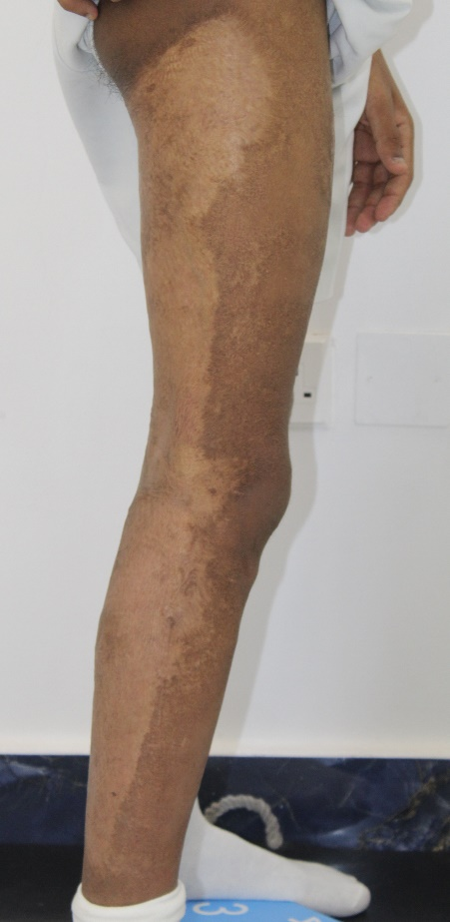
Patient’s Photos
BEFORE
AFTER
Improvement in contracture

Slide 5
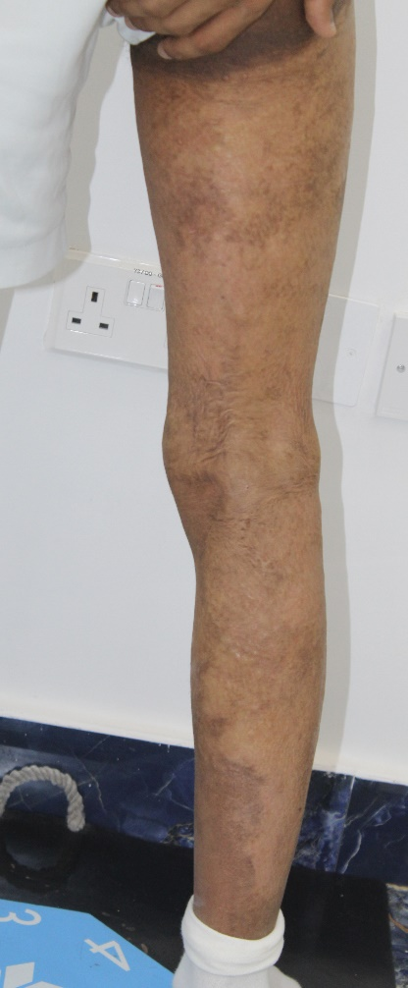
Patient’s Photos
BEFORE
AFTER

Slide 6
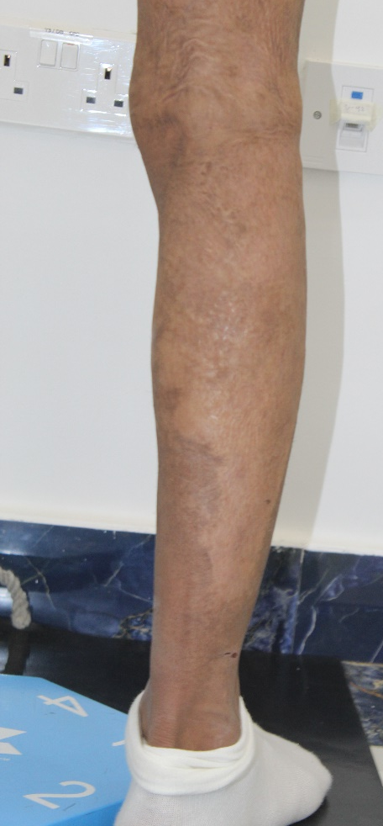
Patient’s Photos
BEFORE
AFTER

Slide 7
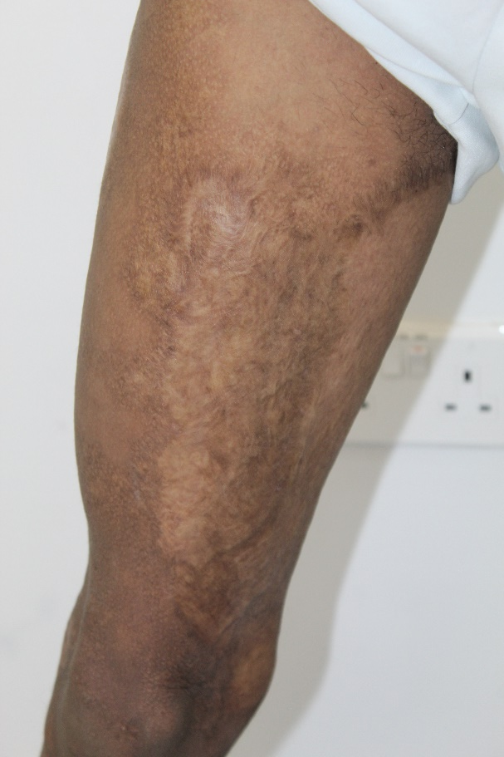
Patient’s Photos
BEFORE
AFTER
Improvement in contracture

Slide 8
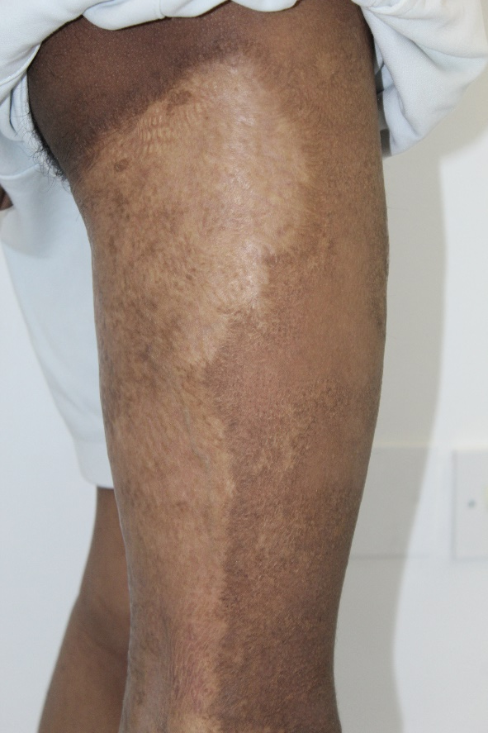
Patient’s Photos
BEFORE
AFTER

Slide 9
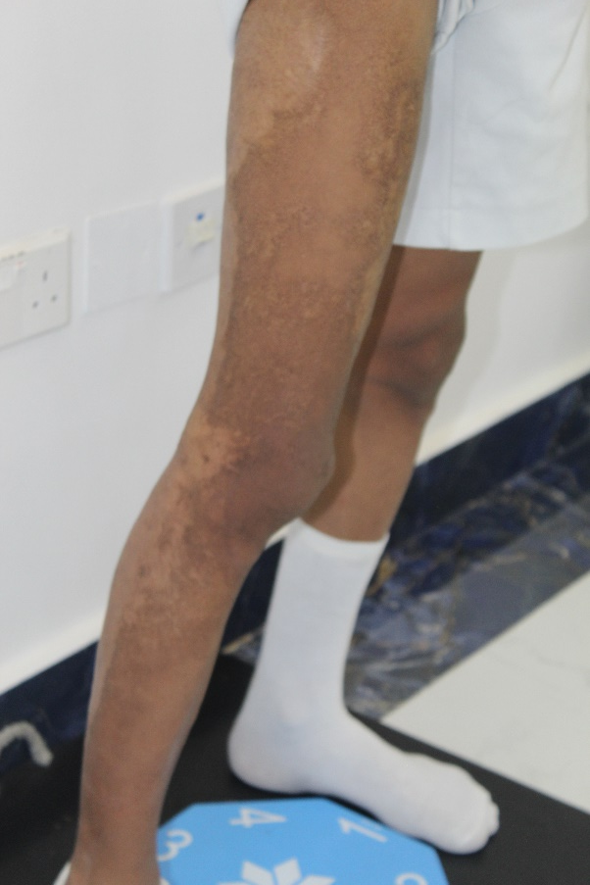
Patient’s Photos
BEFORE
AFTER
Softer Scare contracture
Decrease in contracture area

Slide 10
Observations by Taleb's Patents
His mother noticed that the burn scars got much better after starting the treatment.
Taleb also reported a reduction in tightness in his knee, complete absence of itching.
Observations by Doctor
There is a notable decrease in erythema, This change suggests an improvement in the scar's healing and normalization process.
The scar exhibited signs of improved pigmentation, improvement in pliability as the scar becoming more supple and less tight.
Observed improvement in walking functionality.

Slide 11
Patient Information
Patient Name: Al Reem Sulaiman Saeed Al Baloushi MRN: 23742 Mobile Number: 0506168693 Date of Birth: 08 October 2011 Age: 12 years old Nationality: United Arab Emirates Gender: Female Emirates ID : 784-2011-7147538-3

Slide 12
Patient History
Patient Al Reem, a 12-year-old girl, suffered a high-grade burn accident in August 2015, Affecting 81% of her body surface area.
Necessitating treatment in a PICU and subsequent transfers to Germany and the USA for extensive care, including skin grafts and laser resurfacing.
Her medical background is marked by Beta Thalassemia Major, requiring blood transfusions and a bone marrow transplant from her brother in 2014.
Al Reem did not show any physical sexual characteristics and it was very clear that the areas of her breast, axillary and pubic hair had significant burn including third degree.
Her scars, covering 81% of her body, are firm and mottled with hyperpigmentation.
Al Reem was evaluated at Johns Hopkins, USA in April 2022, by Paediatric Endocrinology, Dr Mindy Sue Christianson. She had appropriate linear growth. No signs of pubertal secondary sexual characteristics. No menstrual periods.

Slide 13
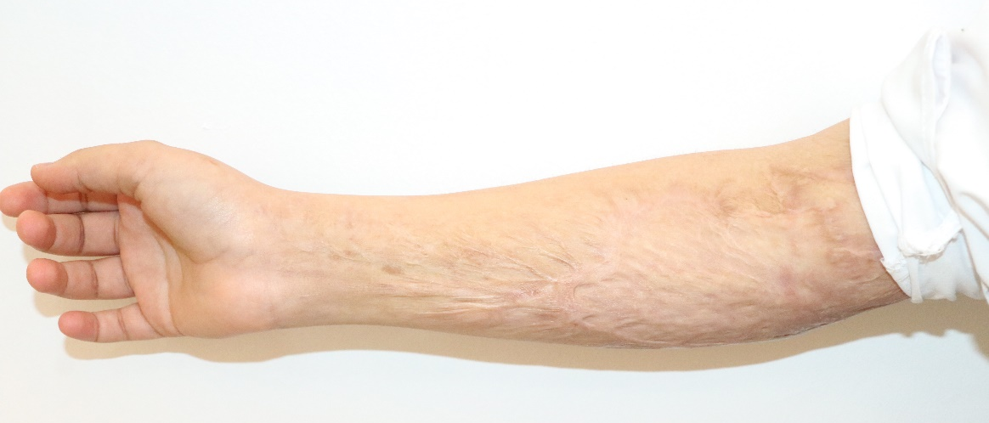
Patient’s Photos
BEFORE
AFTER

Slide 14
Patient’s Photos
BEFORE
AFTER

Slide 15
Patient’s Photos
BEFORE
AFTER

Slide 16
Patient’s Photos
AFTER
BEFORE

Slide 17
Observations by Al Reem's Parents
Her mother reported that Improvements in the treated area are evident when compared to others.
The tightness in her arms has decreased, and the scars are becoming softer with each session, leading to improved mobility in her arms.
Observations by Doctor
There has been a decrease in the vascularity of the scar tissue, and the scar contracture has softened. The scar's pliability has improved; its texture has become softer and more elastic.
These improvements have further enhanced the functionality and range of motion in the arm.

Slide 18
Patient Information
Patient Name: Saleh Abdulla Khalfan Saleh Almansoori MRN: 23967 Mobile Number: 0509998200 Date of Birth: 28 May 1980 Age: 44 years old Nationality: United Arab Emirates Gender: Male Emirates ID No: 784-1980-6351921-3

Slide 19
Patient History
Patient Saleh is 44 years old male Emirati, came to the center on 11th October, 2023 complaining of spontaneous keloid scars
Mr. Saleh Abdulla al Mansoori is a known to develop Keloid Scarring on his chest, back, shoulders and upper extremities.
Keloid scars are known to be painful and pruritic, and can significantly impair function and patients' quality of life.
Mr. Saleh has been suffering from Keloid scars for more than ten years, and has underwent multiple sessions of intralesional Triamcinolone injection but the improvement was unsatisfactory.
Patient’s two sisters and one brother are having the same condition.

Slide 20
Patient’s Photos
BEFORE
AFTER

Slide 21
Patient’s Photos
BEFORE
AFTER

Slide 22
Patient’s Photos
BEFORE
11 October 2023
AFTER
27 August 2024

Slide 23
Patient’s Photos
BEFORE
11 October 2023
AFTER
27 August 2024

Slide 24
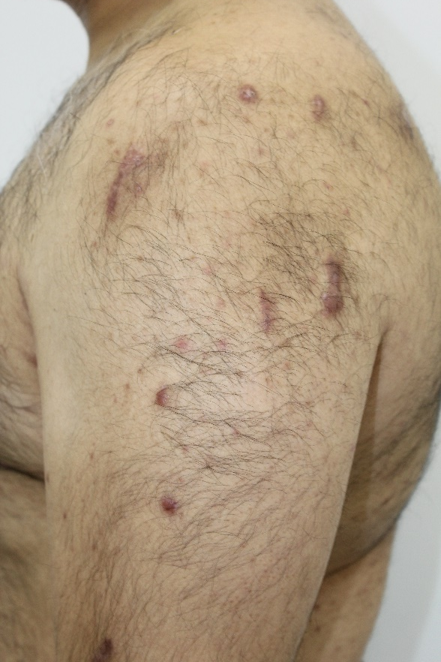
Patient’s Photos
BEFORE
AFTER
11/10/2023
14/05/2024

Slide 25
Observations by Saleh
Patient Saleh reported initial improvements in his keloid scar following the first treatment session.
He observed that the scar began to shrink gradually and became softer.
Observations by Doctor
The texture of the scar has become significantly softer, indicating enhanced pliability.
These changes suggest a positive response to the treatment, with the scar demonstrating reduced contracture and increased elasticity.

Slide 26
Patient Information
Patient Name: Khalifa Hamad Hareb Salem Almheiri MRN: 24328 Mobile Number: 0506163113 Date of Birth: 26 July 2012 Age: 11 years old Nationality: United Arab Emirates Gender: Male Emirates ID No: 784-2012-6543638-2

Slide 27
Patient History
Patient Khalifa is an 11-year-old male Emirati child who came to everlast on 7th January 2024, with a history of keloid scars on the neck.
These scars resulted from an accident in which he was accidentally dragged by a rope and a motorcycle on 18th March 2023.
Patient was transferred to the nearest emergency just for cleaning, after 7 days he went to Khalifa hospital and took medication (Mebo cream).
In June 2023, the patient received corticosteroid injections for most of their injuries at the clinic in Dubai.
The patient is psychologically affected and has had a very painful and negative experience with the previous treatment he underwent, which prevented him from completing it.

Slide 28
Patient’s Photos
BEFORE
AFTER
Decrease in size
Scars have flattened
15/01/2024
14/05/2024

Slide 29
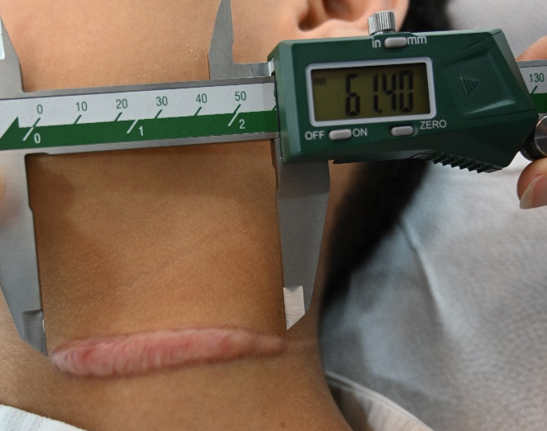
Patient’s Photos
AFTER
BEFORE
Decrease in size

Slide 30
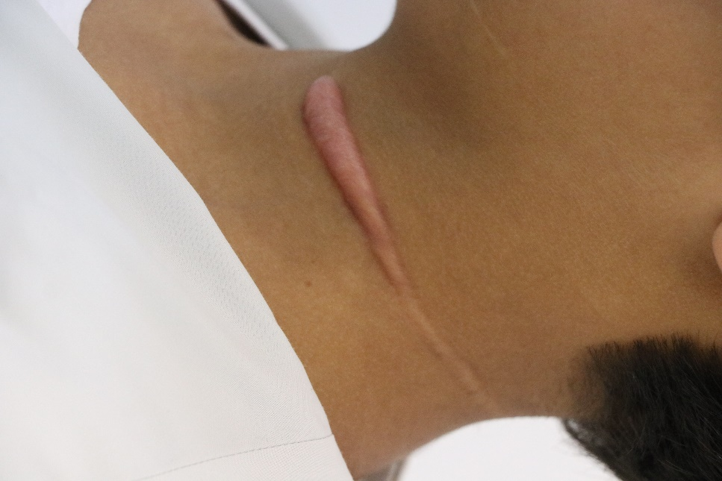
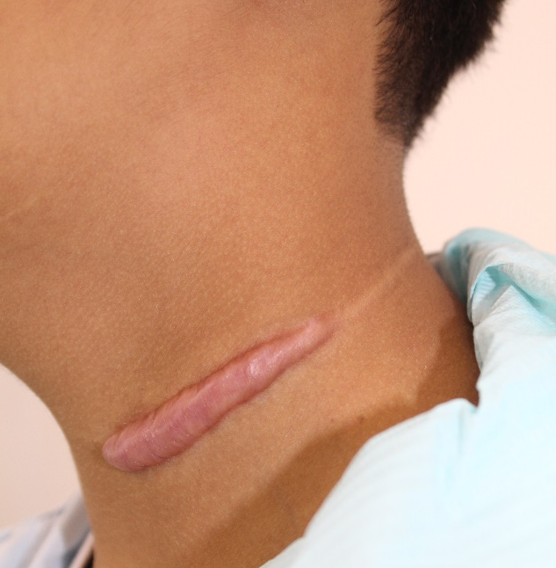
Patient’s Photos
BEFORE
AFTER
Scars have flattened
15/01/2024
14/05/2024

Slide 31
Observations by Khalifa's Parents
We have observed notable improvements in the condition of Khalifa's scars. Specifically, there has been a reduction in their size, in tightness.
Also, Khalifa no longer experiences pain or itching in the affected areas.
Observations by Doctor
A marked decrease in both the height and thickness of the scar, The texture has notably softened, suggesting improved pliability.
Additionally, there has been a noticeable reduction in erythema.
Improvement in the functional mobility of the cervical region.

