Slide 1
Patient Name: Amira Ebrahim
Patient Details:
Female , 32 years old
Complain:
Burn on upper legs
Treatment:
………..

Slide 2
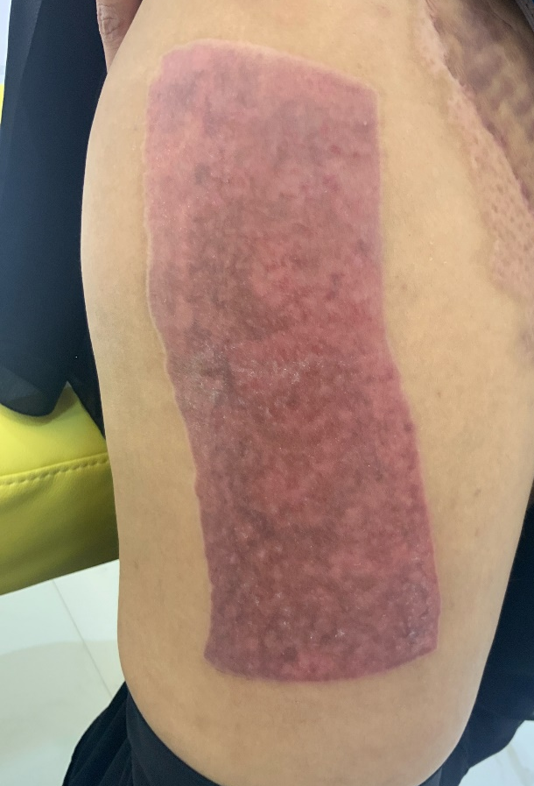
Before 07/ 10/2024
After19/11/2024

Slide 3
Before 07/ 10/2024
After19/11/2024

Slide 4
Before 07/ 10/2024
After19/11/2024

Slide 5
Before 07/ 10/2024
After19/11/2024

