Slide 1
Case Report Patient 22187

Slide 2
Patient Information:
Patient Name: Youssef Farah Saad Zaky
MRN: 22187
Mobile Number: 0564574486
Date of Birth: 15 August 1992
Age: 31 yrs old
Nationality: Egypt
Gender: Male
Emirates ID No.: 784-1992-8503208-4

Slide 3
09 January 2023
Doctor’s Treatment Plan:
Steroid injection monthly
Fractional laser +SVF or healer monthly
RF Microneedling + exosome monthly
Hair Exosome on scalp

Slide 4
12 September 2023
Doctor’s Treatment Plan:
Area 1 (left face) Fractional
Area 2 (scalp) Multifrax
Area 3 (left shoulder) Pico
Area 4 (left elbow, left arm) Fractional
Area 5 (left hand) RF Micro Needling
One month Renuva
One month SVF

Slide 5
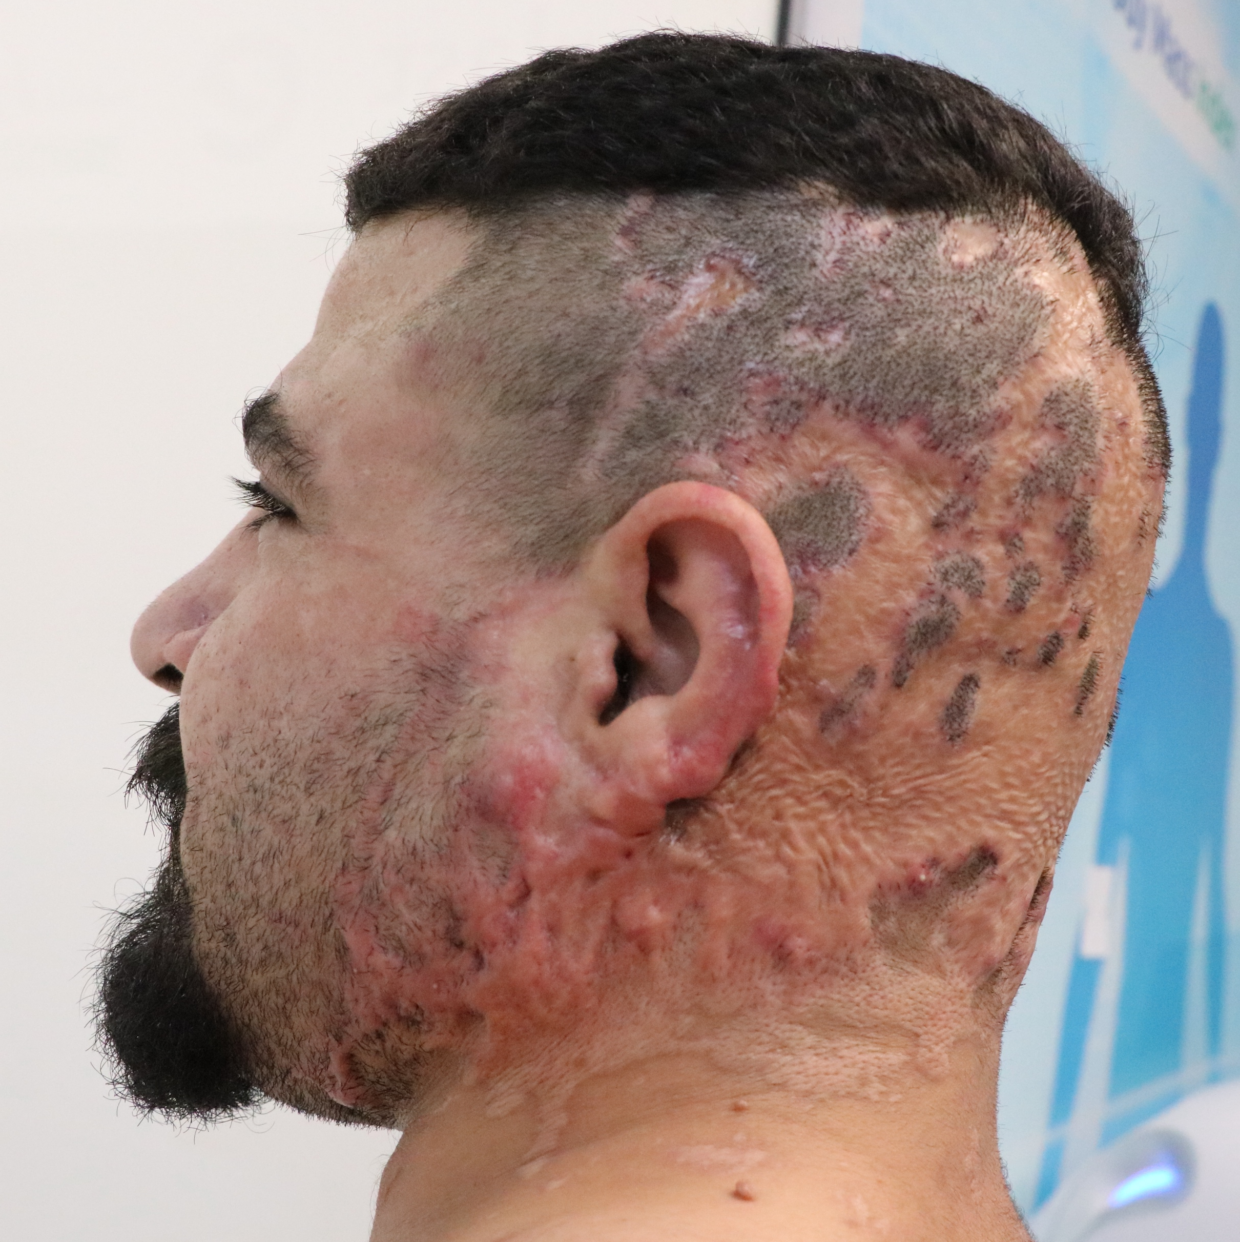
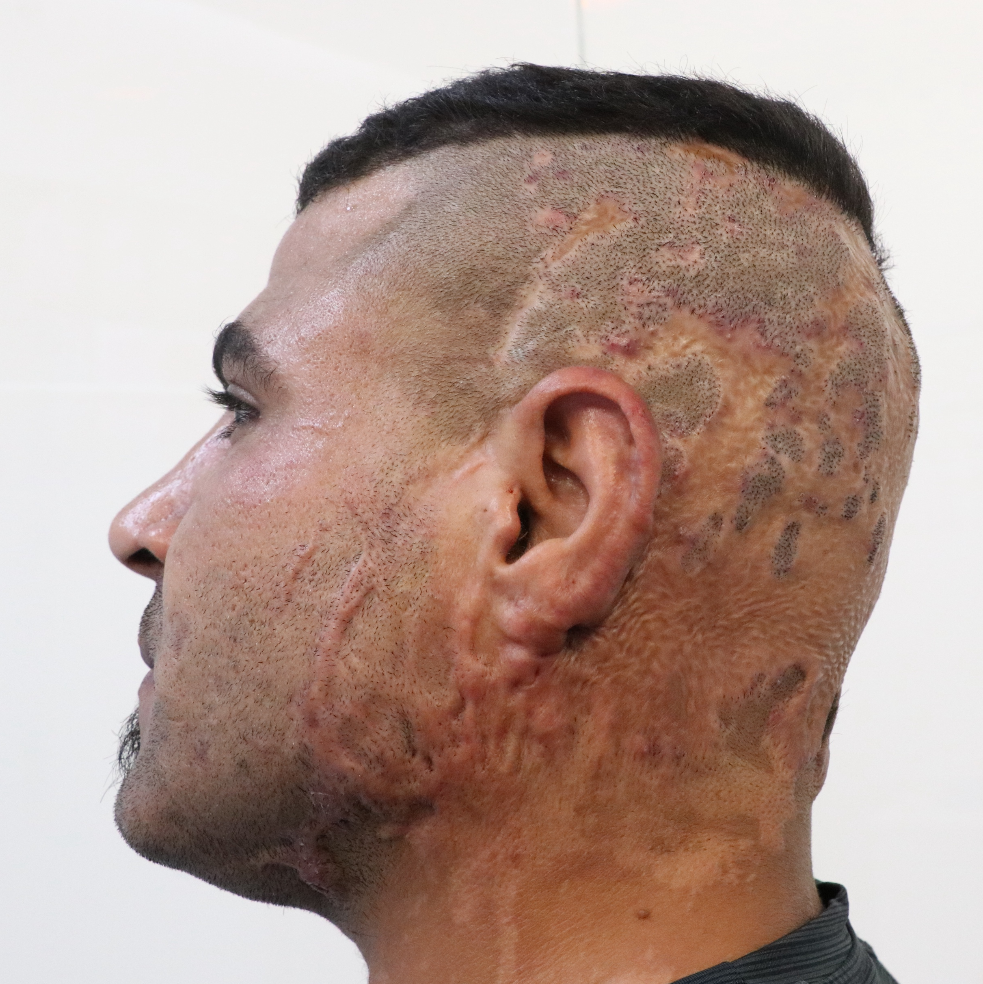
Patient’s Photos (Area 1 left face)
09 January 2023
22 June 2023

Slide 6
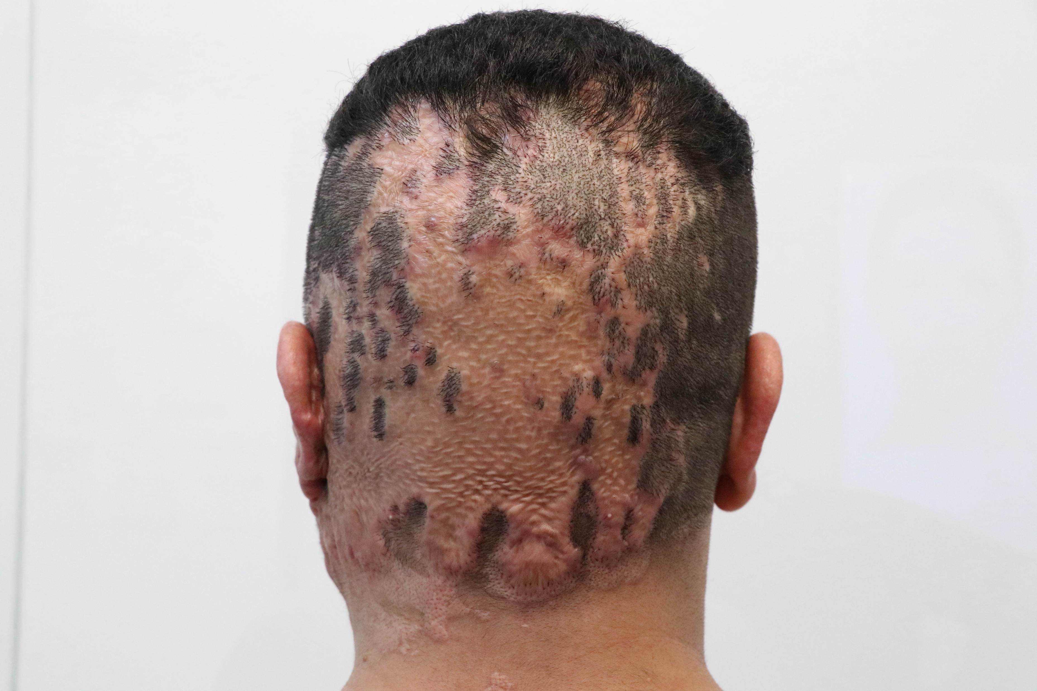
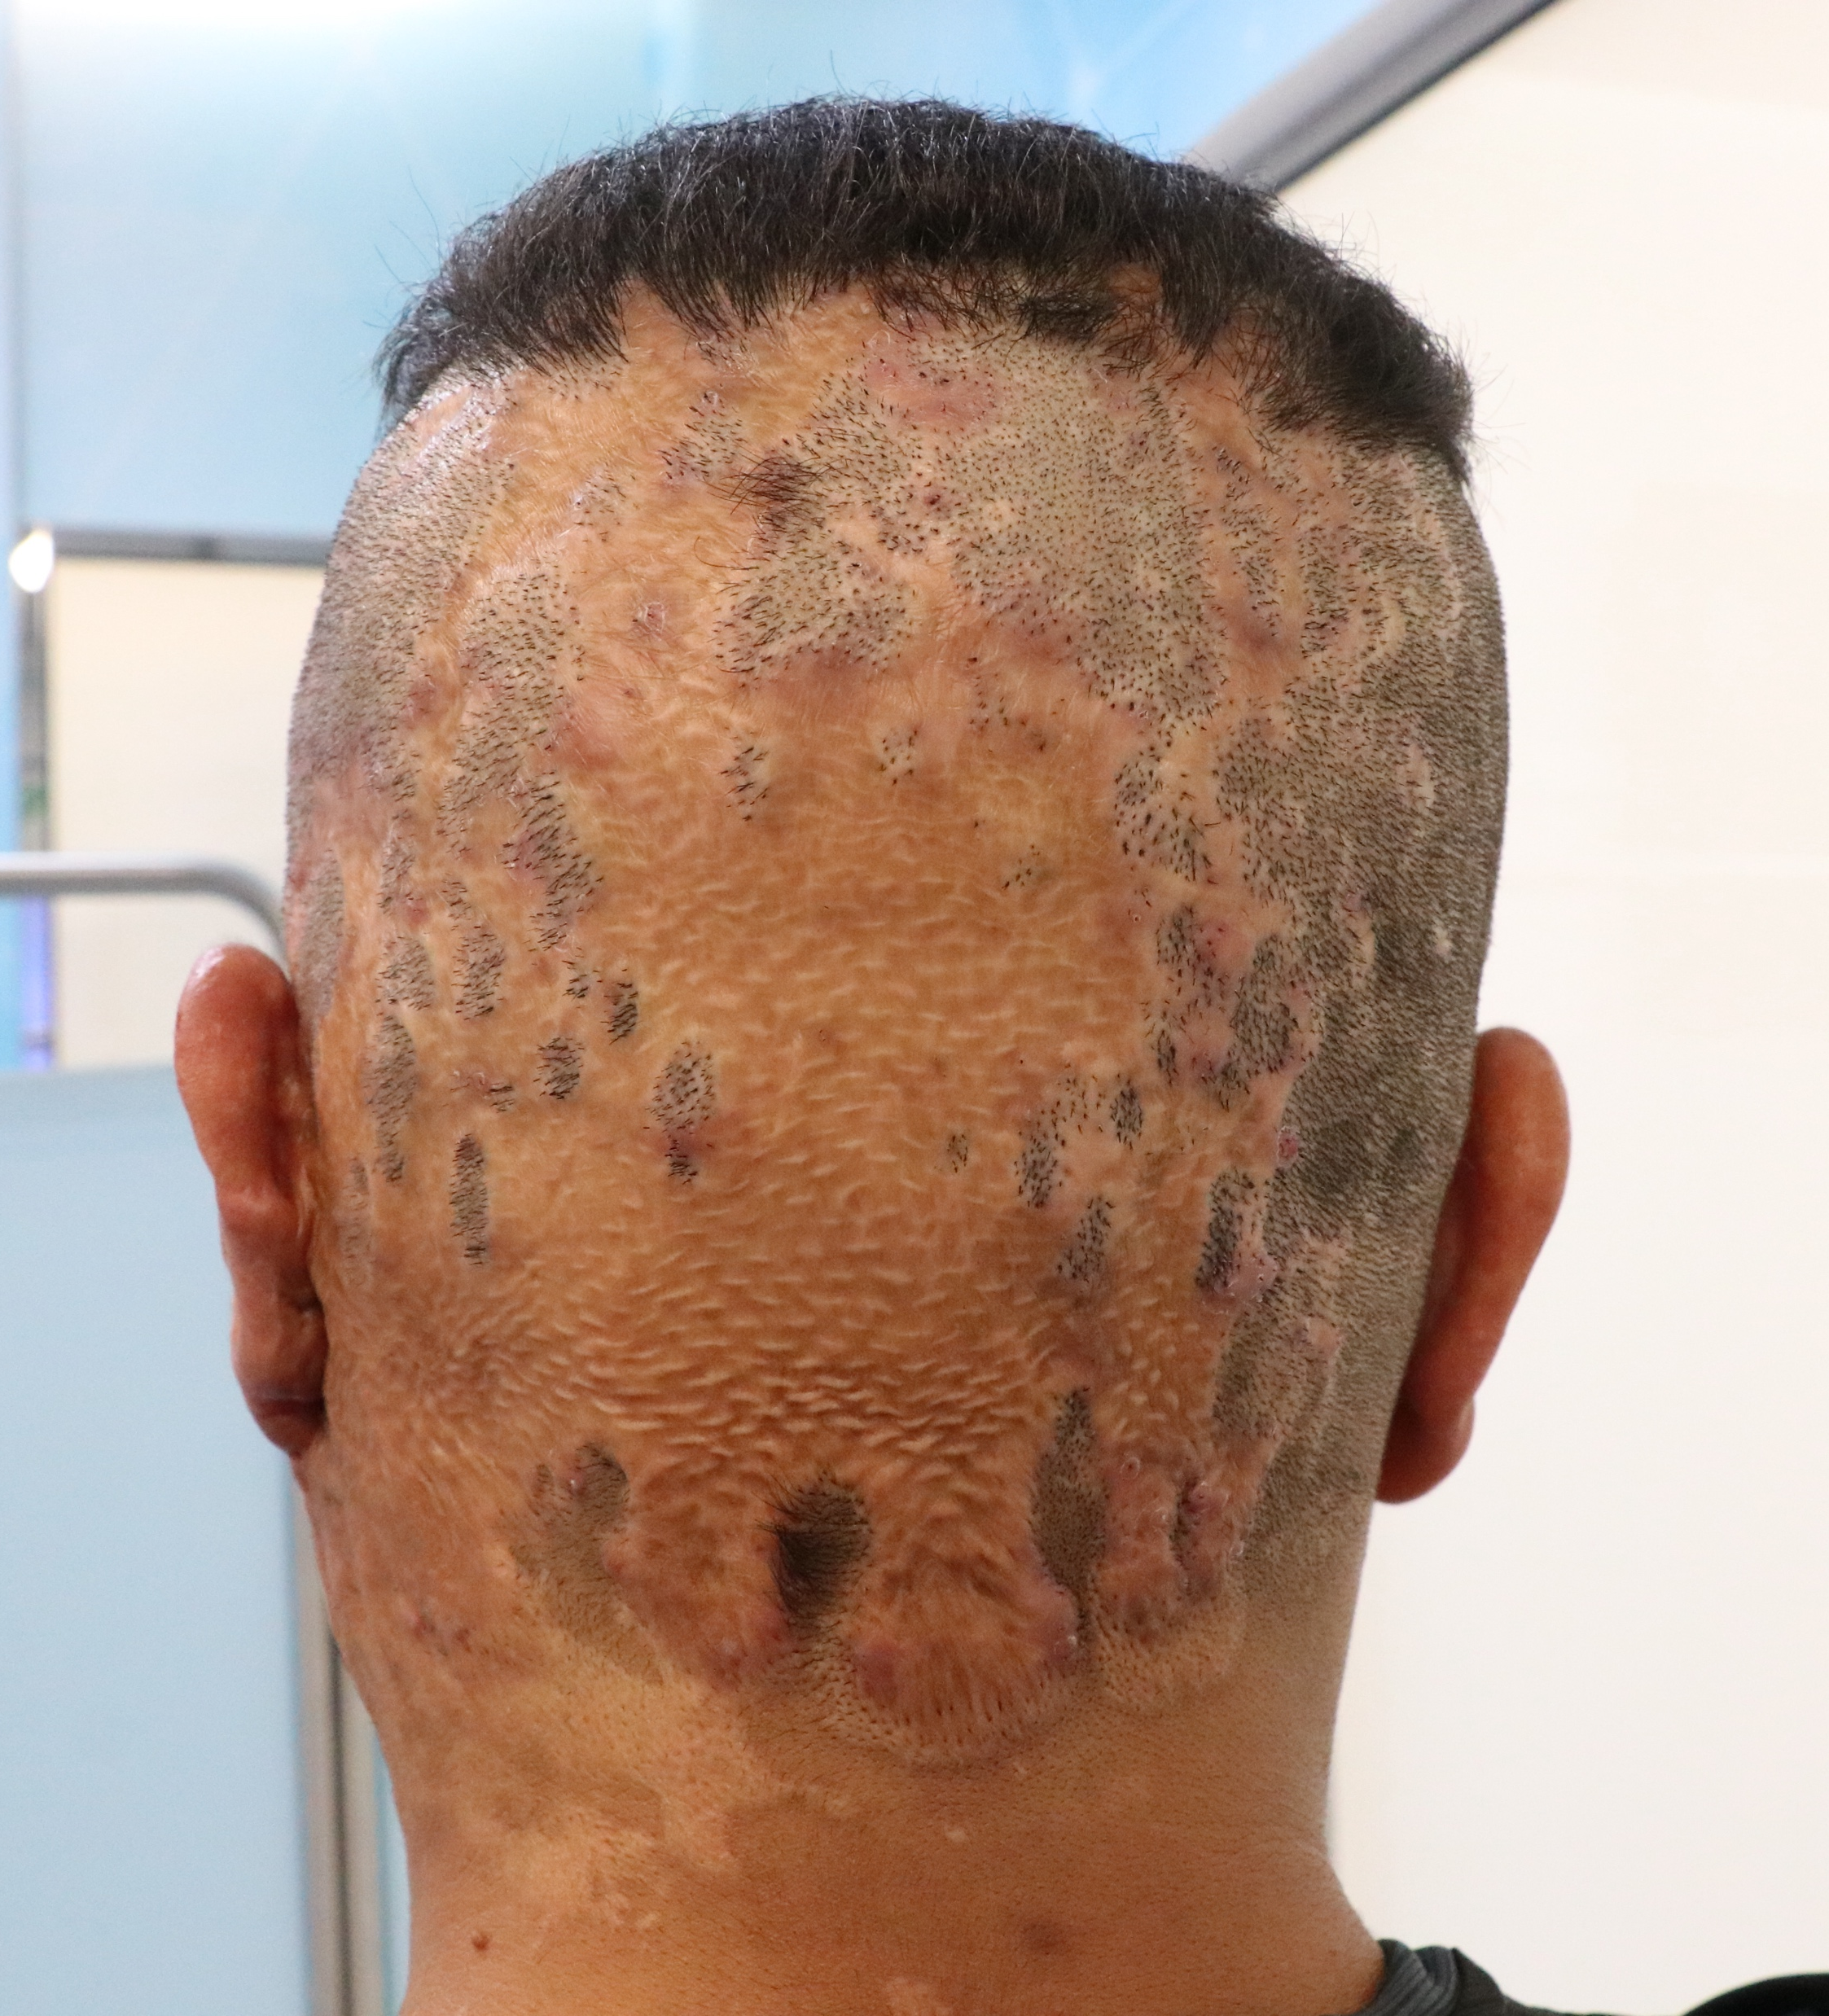
Patient’s Photos (Area 2 scalp)
09 January 2023
22 June 2023

Slide 7
Patient’s Photos (Area 3 left shoulder)
09 January 2023
22 June 2023

Slide 8
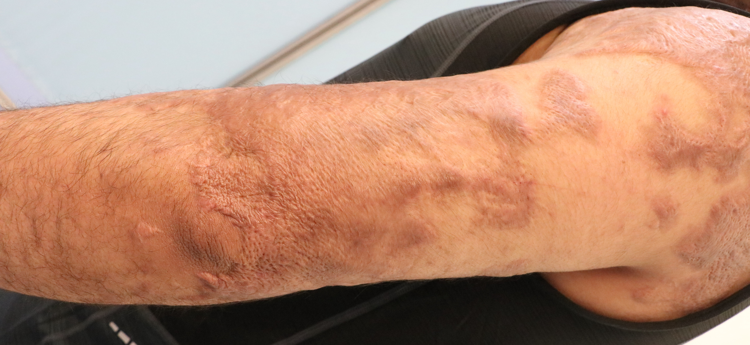
Patient’s Photos (Area 4 left elbow)
09 January 2023
22 June 2023

Slide 9
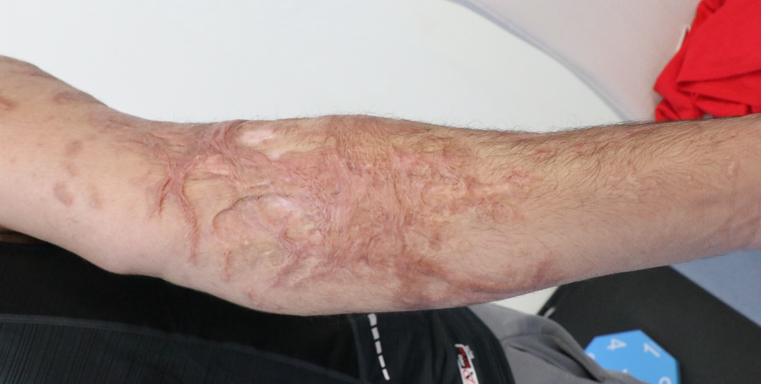
Patient’s Photos (Area 4 left arm)
09 January 2023
22 June 2023

Slide 10
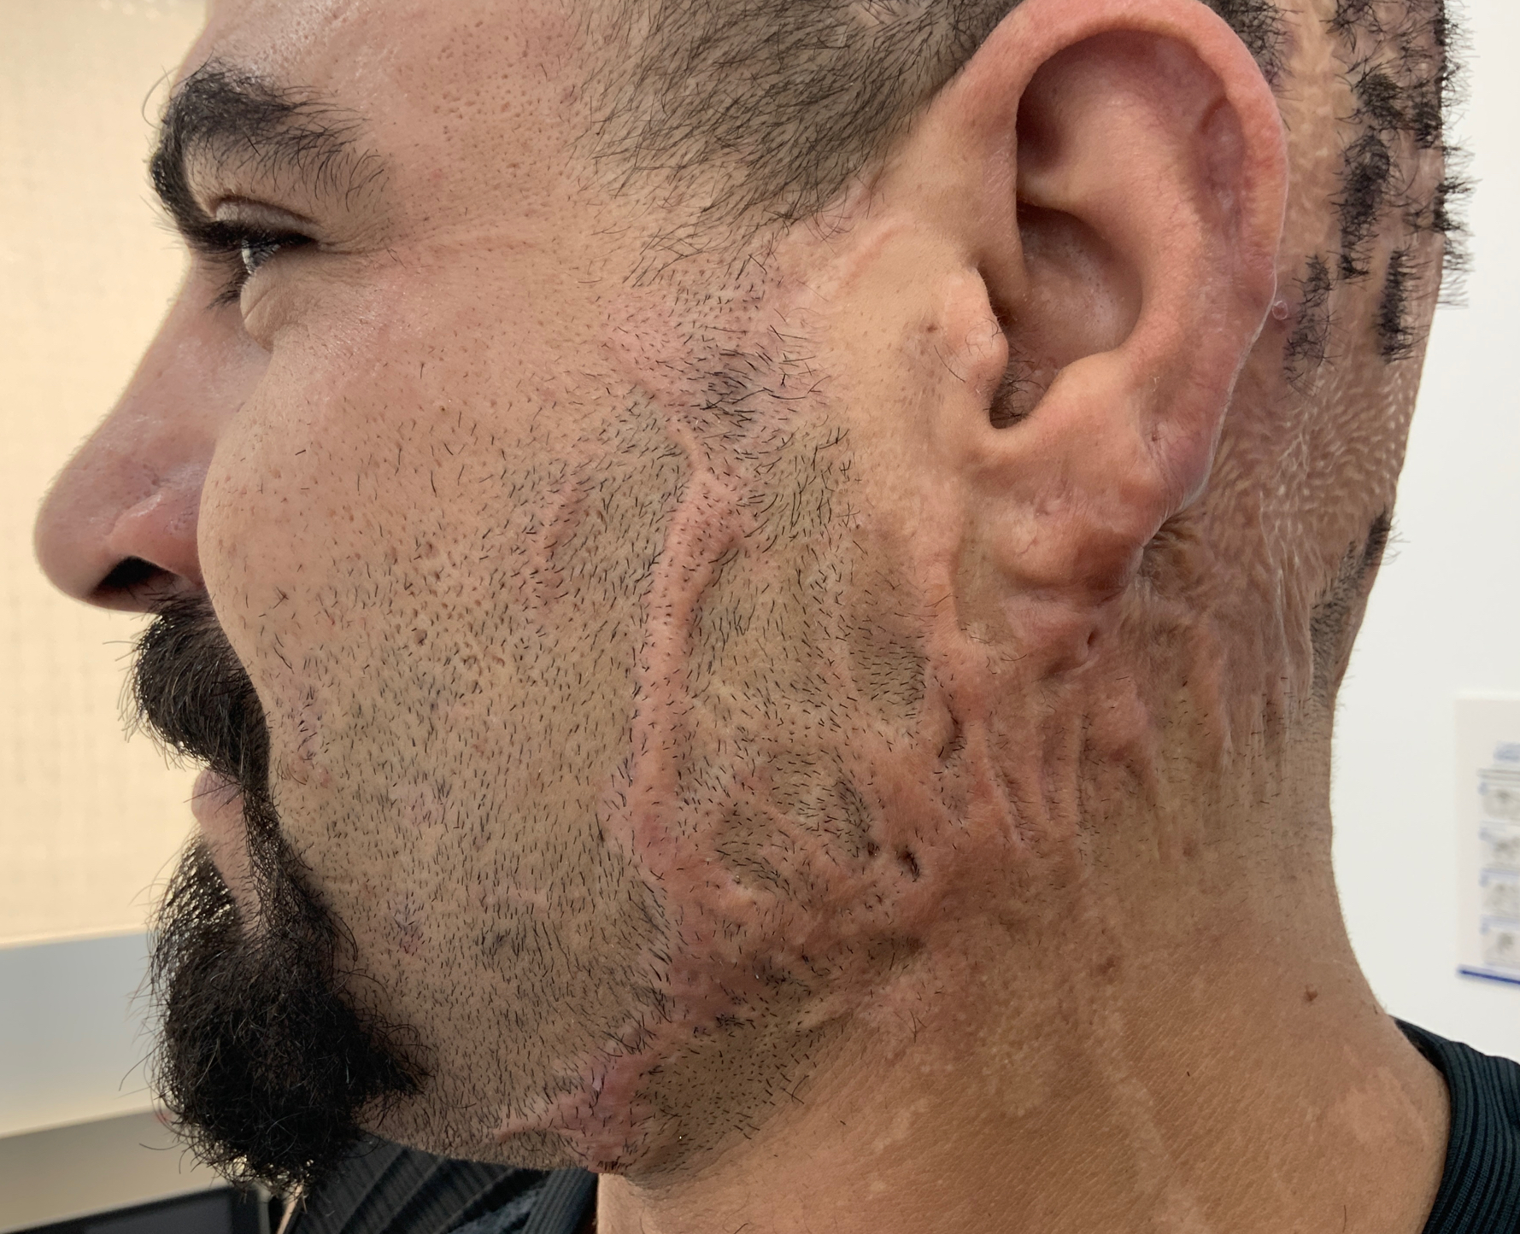
Patient’s Photos
Patient’s Photos (Area 1 left face)
09 January 2023
12 September 2023

Slide 11
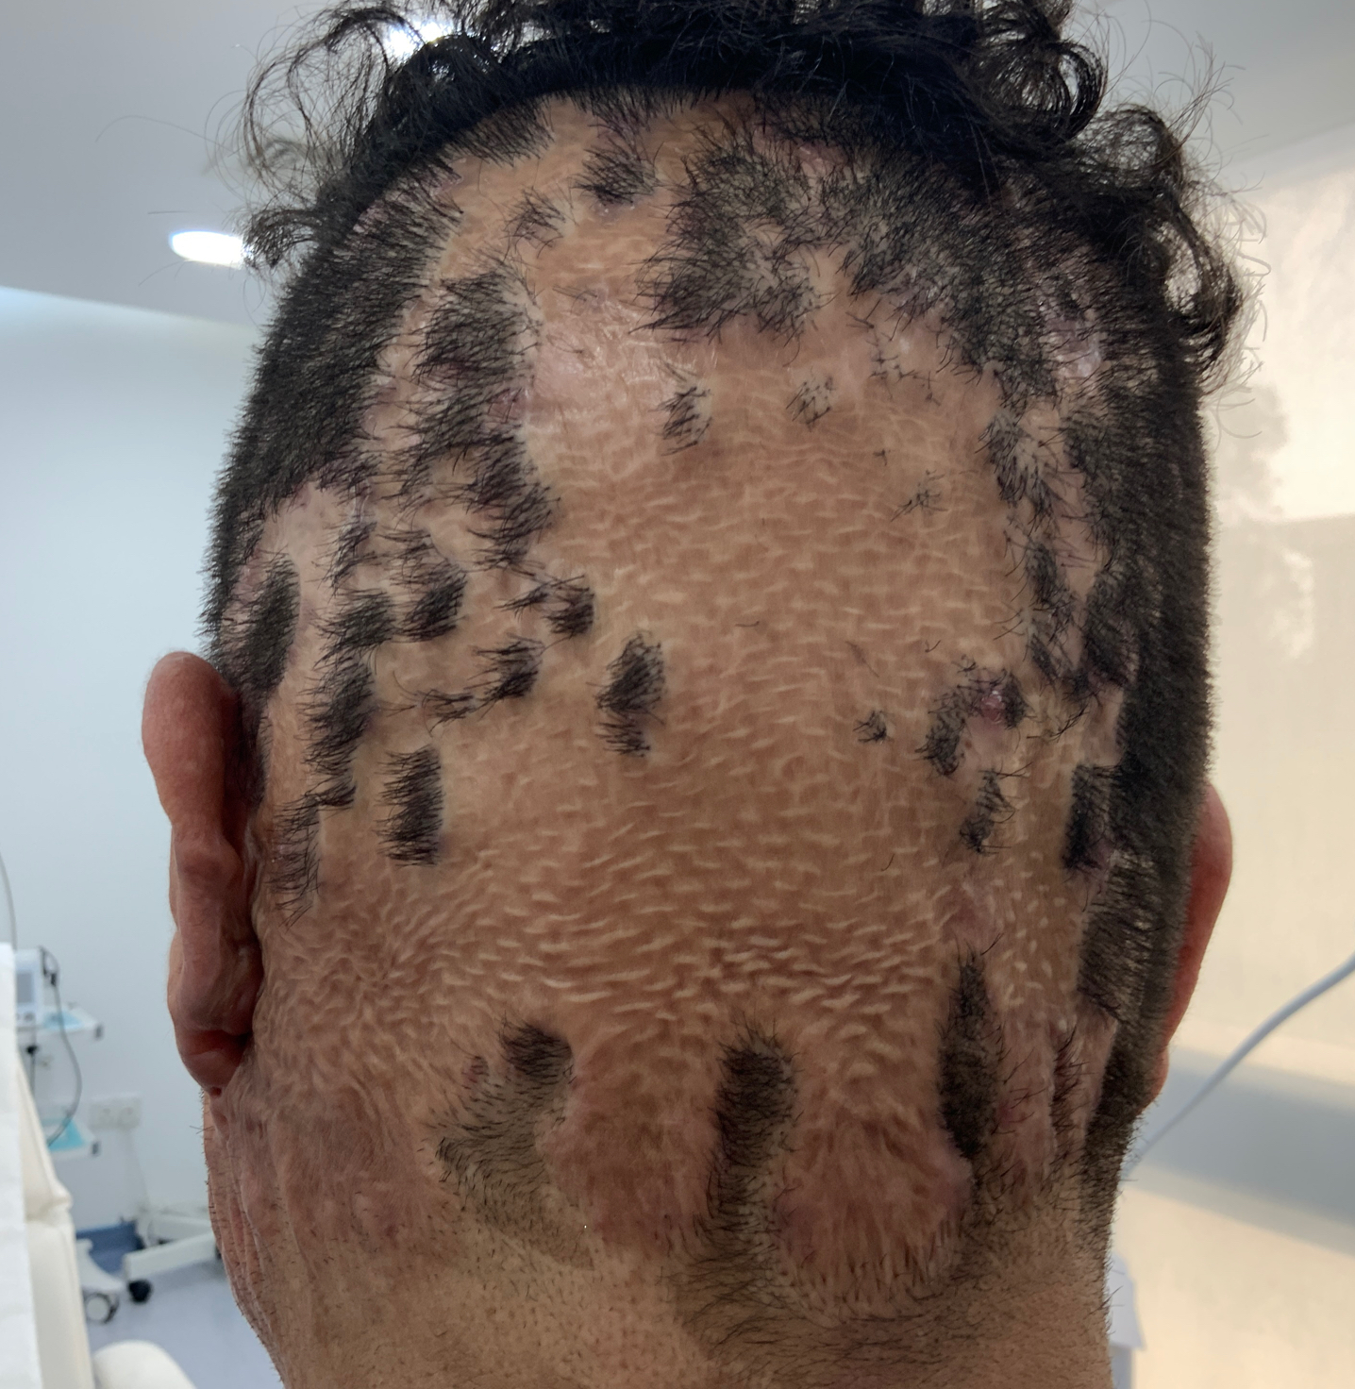
Patient’s Photos
Patient’s Photos (Area 2 scalp)
09 January 2023
12 September 2023

Slide 12
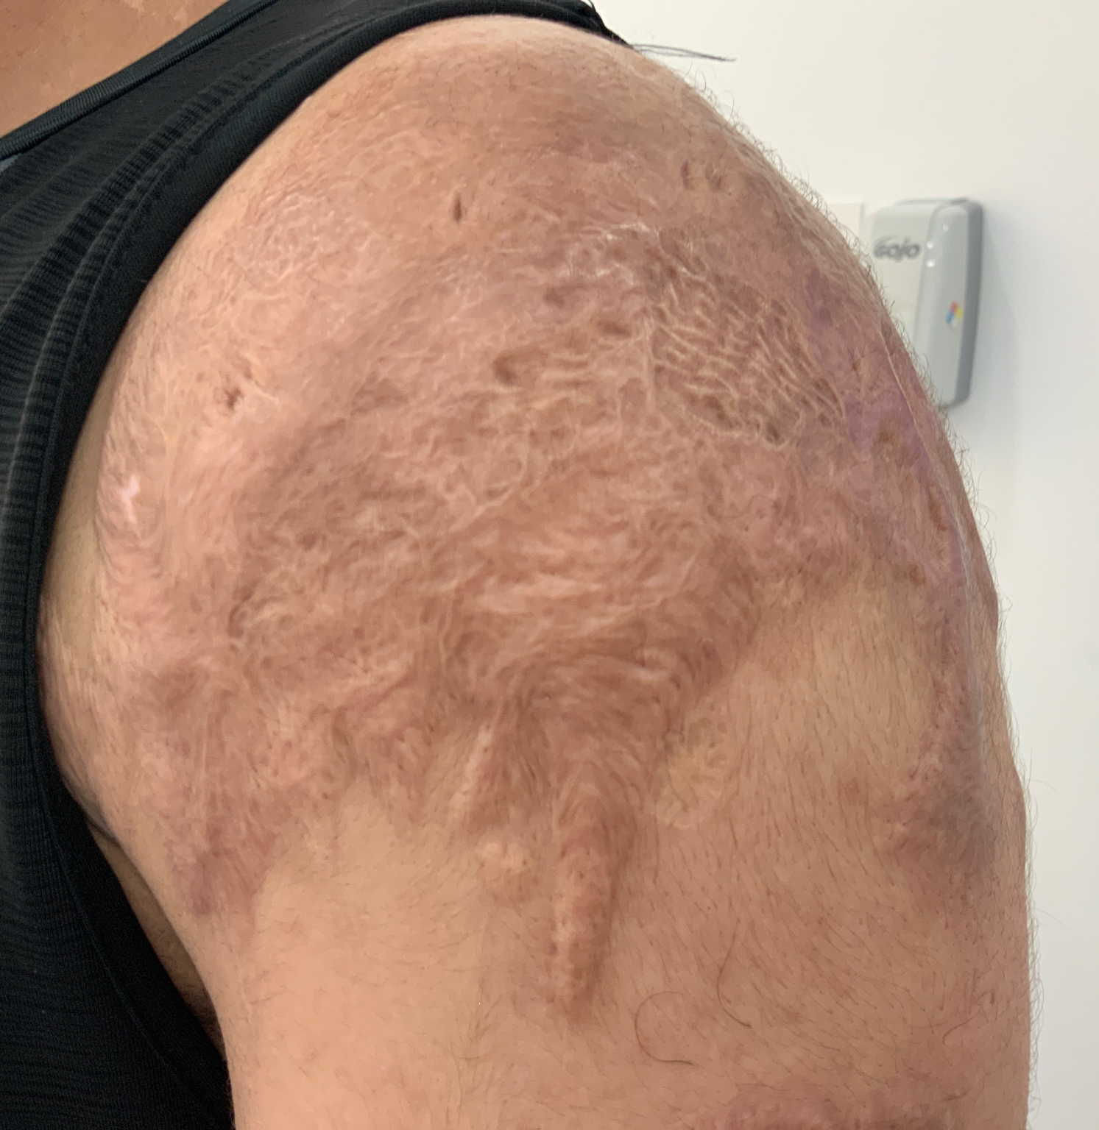
Patient’s Photos
Patient’s Photos (Area 3 left shoulder)
09 January 2023
12 September 2023

Slide 13
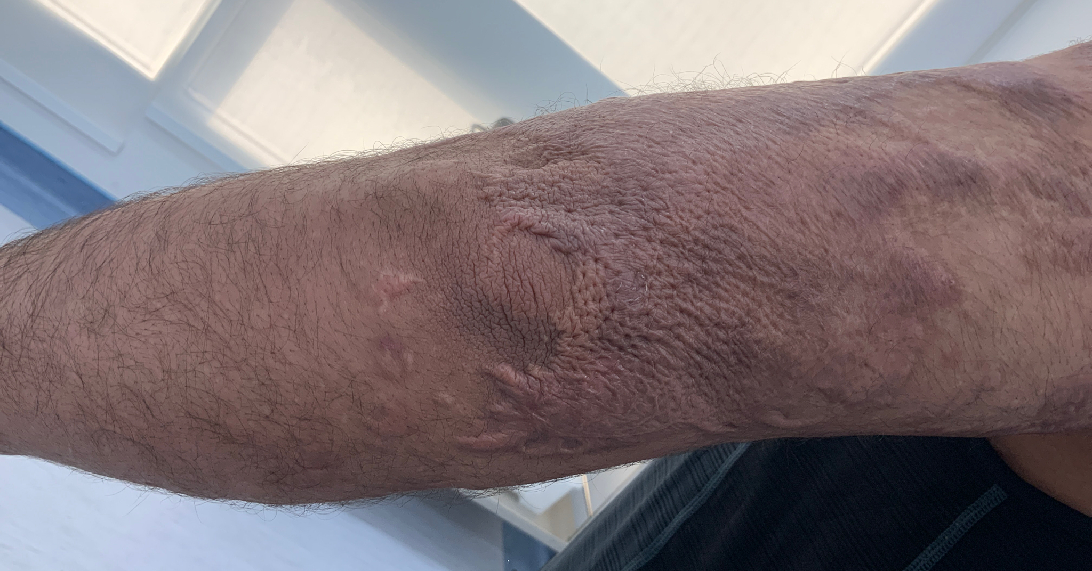
Patient’s Photos (Area 4 left elbow)
09 January 2023
12 September 2023

Slide 14
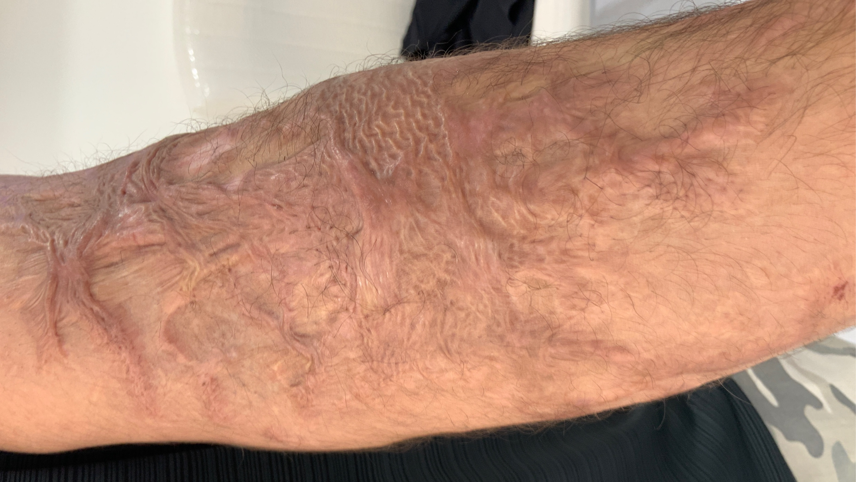
Patient’s Photos (Area 4 left arm)
09 January 2023
12 September 2023

Slide 15
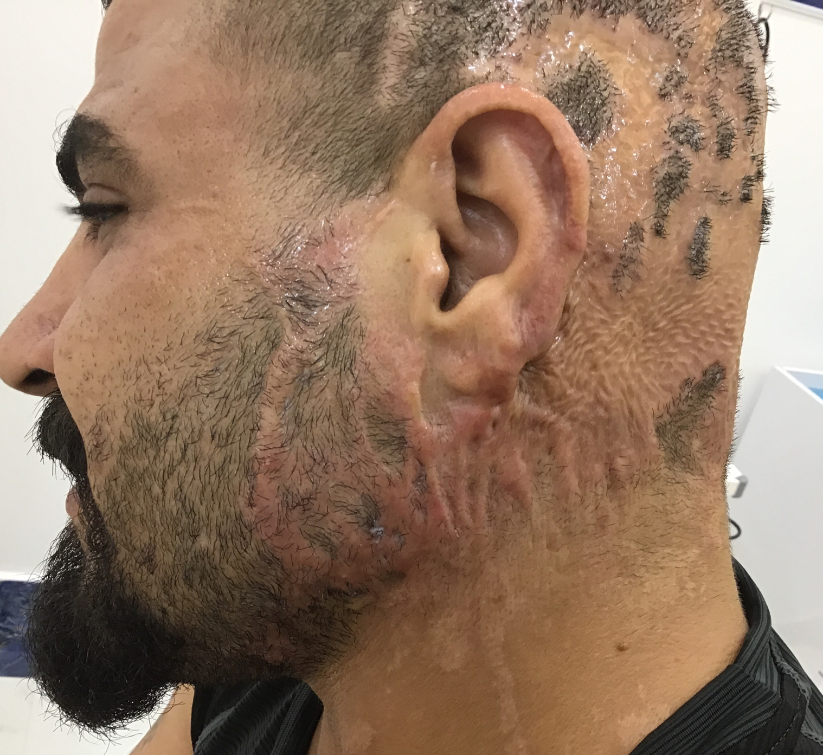
Patient’s Photos (Area 1 left face)
09 January 2023
25 October 2023

Slide 16
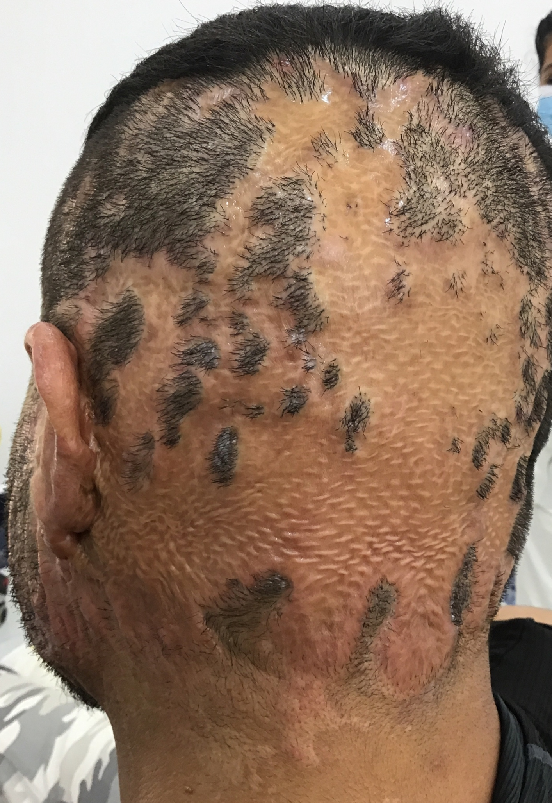
Patient’s Photos (Area 2 scalp)
09 January 2023
25 October 2023

Slide 17
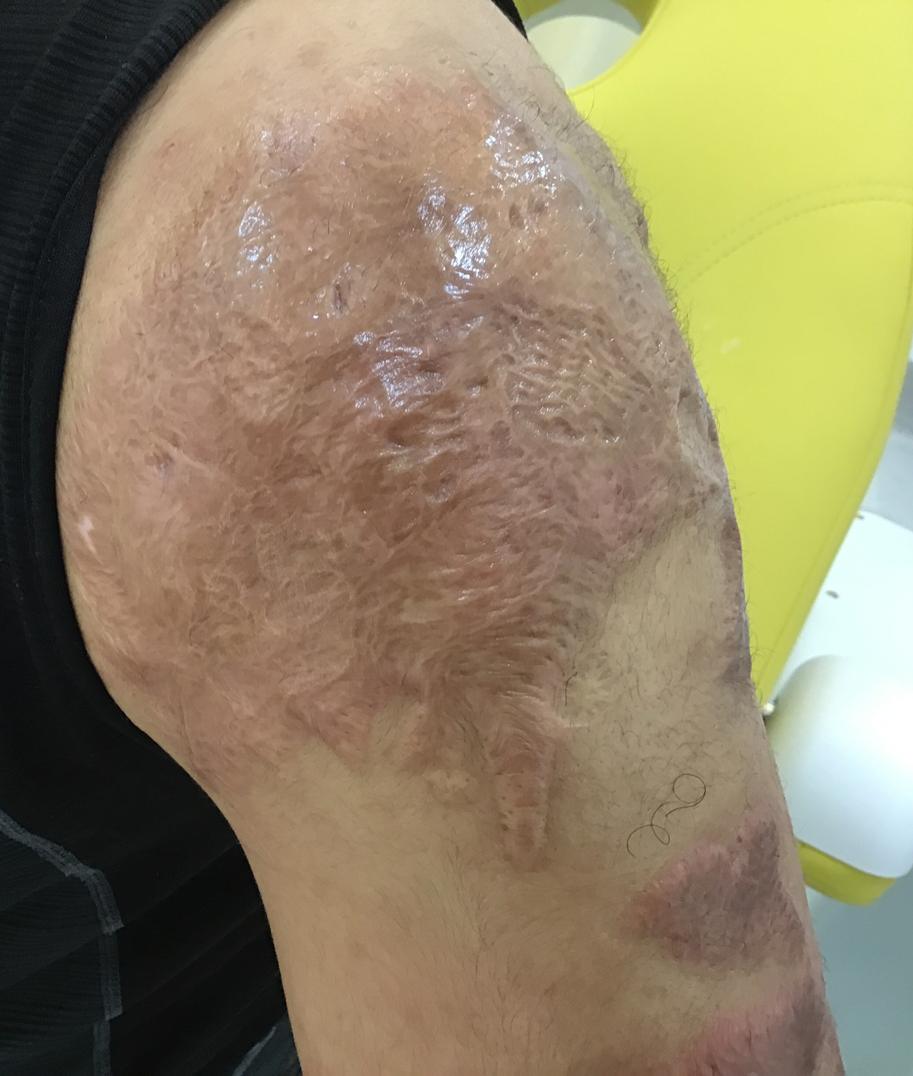
Patient’s Photos
Patient’s Photos (Area 3 left shoulder)
09 January 2023
25 October 2023

Slide 18
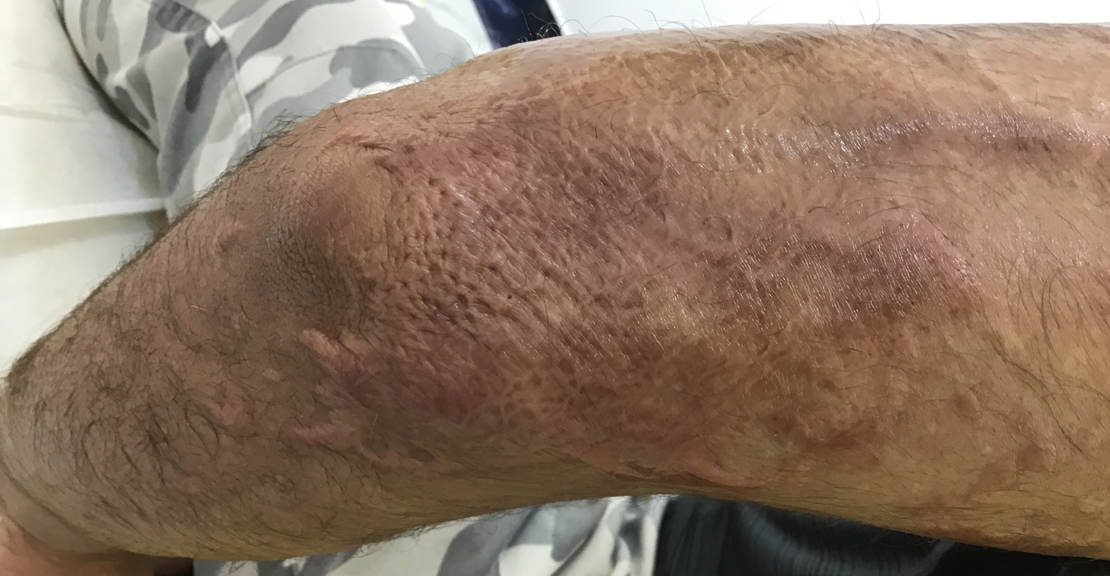
Patient’s Photos (Area 4 left elbow)
09 January 2023
25 October 2023

Slide 19
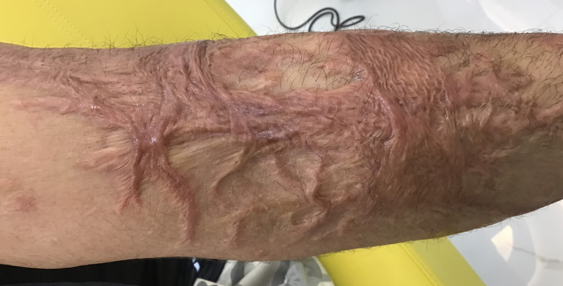
Patient’s Photos (Area 4 left arm)
09 January 2023
25 October 2023

Slide 20
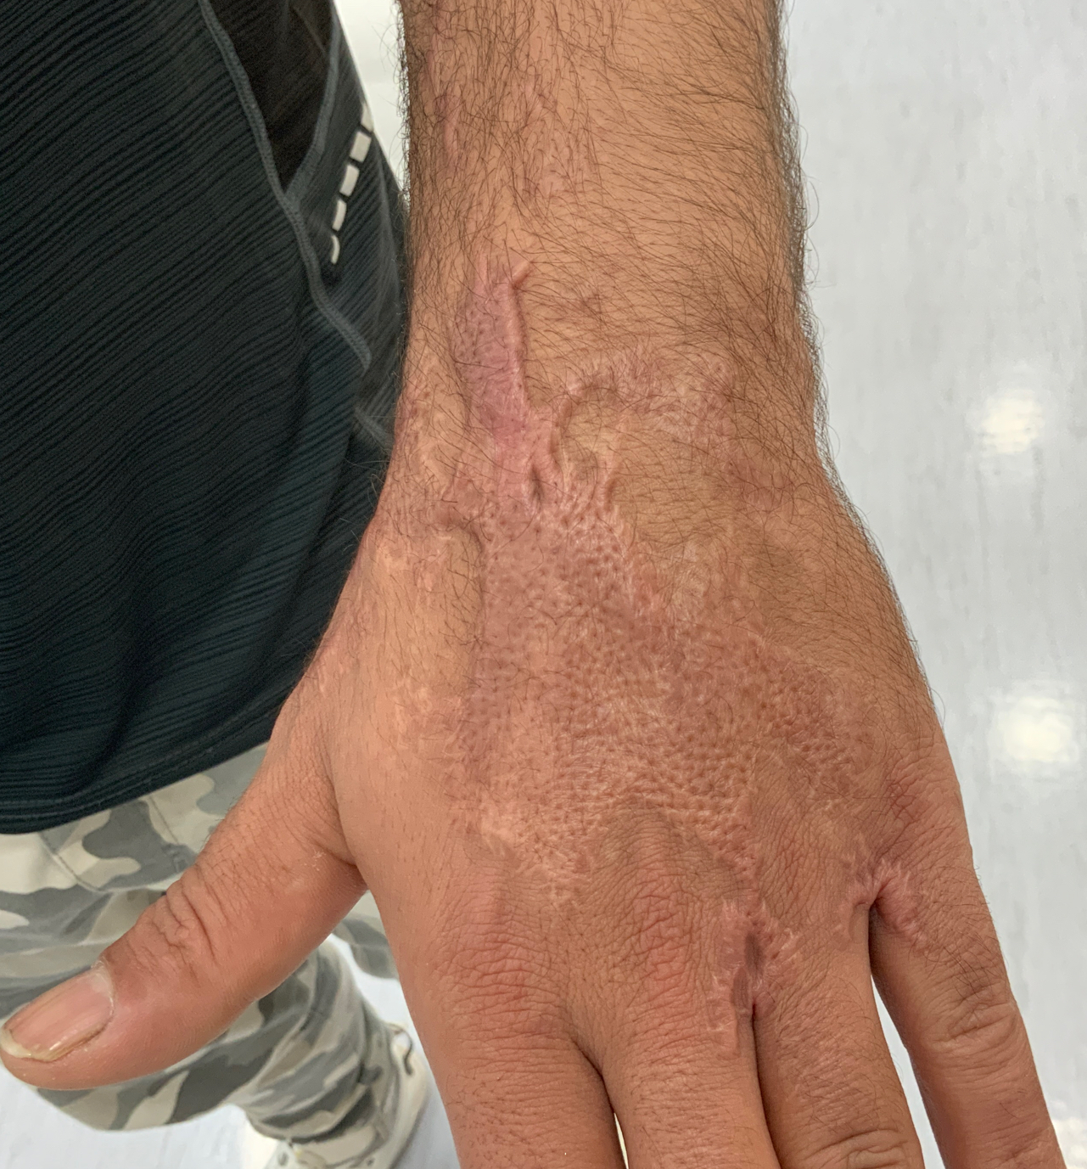
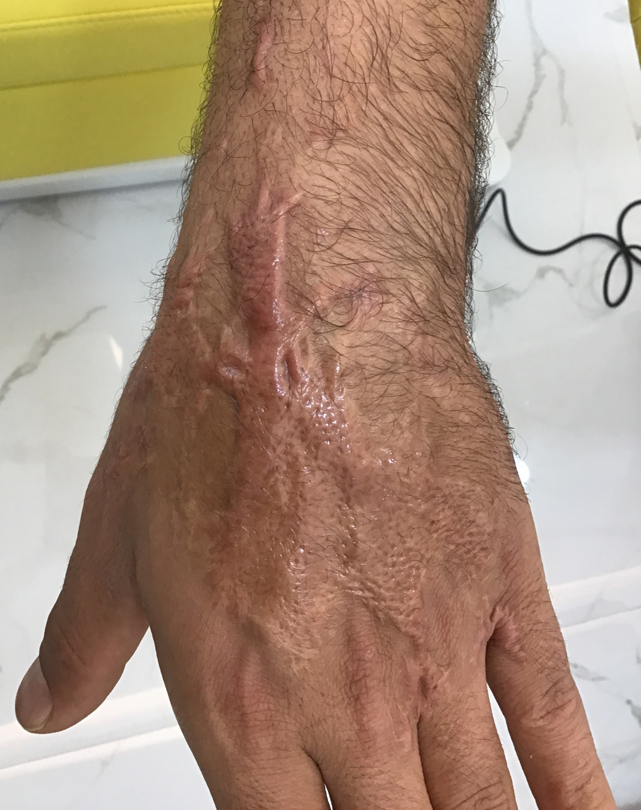
Patient’s Photos
Patient’s Photos (Area 5 left hand)
12 September 2023
25 October 2023

